Slide 1
Final Survey Results
Social and Mobile Computing - Parkit
57 Respondants

Slide 2
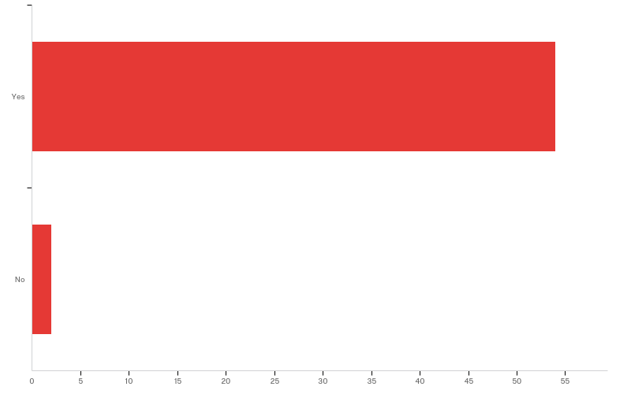
Q8 - Do you agree to participate?

Slide 3
Q8 - Do you agree to participate?
# | Answer | % | Count
1 | Yes | 96.43% | 54
2 | No | 3.57% | 2
 | Total | 100% | 56

Slide 4
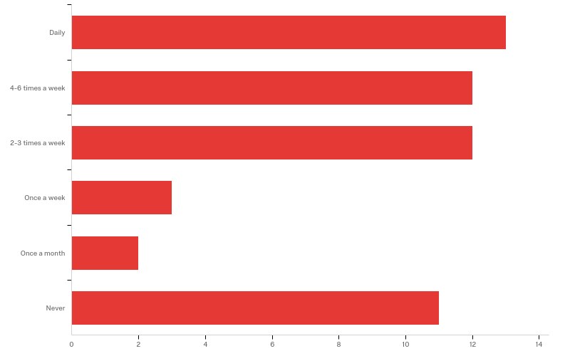
Q9 - How often do you require daily parking?

Slide 5
Q9 - How often do you require daily parking?
# | Answer | % | Count
1 | Daily | 24.53% | 13
2 | 4-6 times a week | 22.64% | 12
3 | 2-3 times a week | 22.64% | 12
4 | Once a week | 5.66% | 3
5 | Once a month | 3.77% | 2
6 | Never | 20.75% | 11
 | Total | 100% | 53

Slide 6
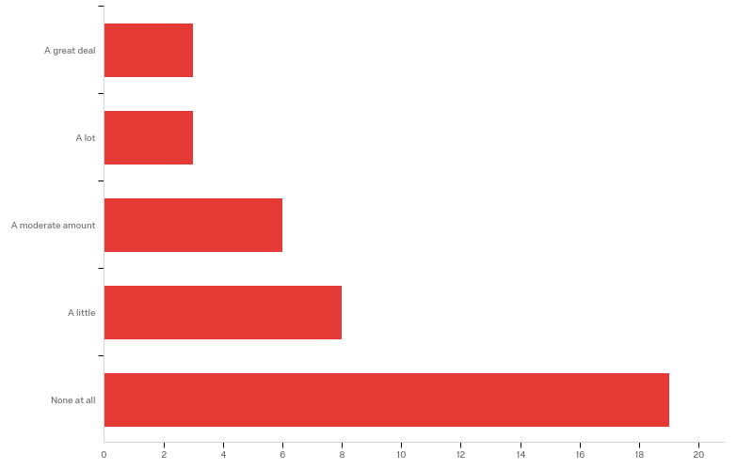
Q10 - How much do you usually pay for parking?

Slide 7
Q10 - How much do you usually pay for parking?
# | Answer | % | Count
1 | A great deal | 7.69% | 3
2 | A lot | 7.69% | 3
3 | A moderate amount | 15.38% | 6
4 | A little | 20.51% | 8
5 | None at all | 48.72% | 19
 | Total | 100% | 39

Slide 8
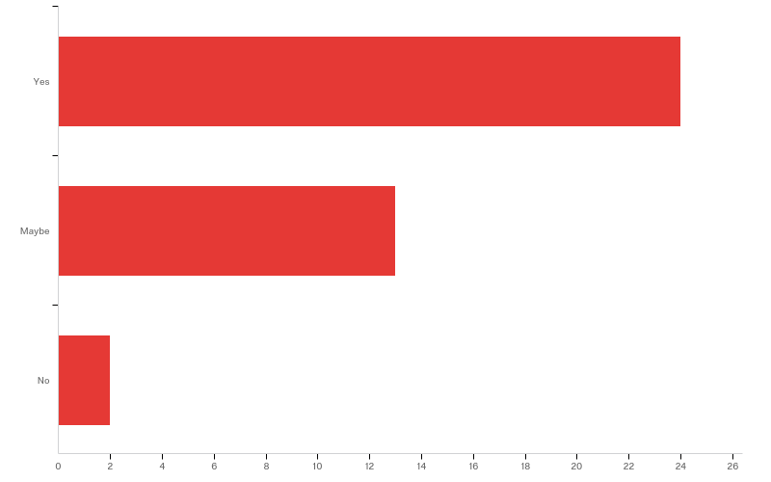
Q11 - Would you be willing to park on someone else’s private property as an alternative?

Slide 9
Q11 - Would you be willing to park on someone else’s private property as an alternative?
# | Answer | % | Count
1 | Yes | 61.54% | 24
2 | Maybe | 33.33% | 13
3 | No | 5.13% | 2
 | Total | 100% | 39

Slide 10
Q12 - What reservations would you have with parking on someone else’s private property?
What reservations would you have with parking on someone else’s private pro...
No infofmation
Nil
Permission
Security
None
None
Car being damaged
security
None
Wide enough driveway for entry and exit
Proximity, open air, security

Slide 11
Q12 - What reservations would you have with parking on someone else’s private property?
What reservations would you have with parking on someone else’s private pro...
Safety for me and cover for my car
Intrusion
The ramifications of doing so - cost, the person's thoughtsvthen actions in regards to regulations and costs, not to mention their needs for their space (destruction to their property, etc.).
Inconvenience and distance
A risk of falling out with that person if we are friends
Being there without permission
access, safety,
security
Security
None

Slide 12
Q12 - What reservations would you have with parking on someone else’s private property?
What reservations would you have with parking on someone else’s private pro...
They may vandalise my car, steal my belongings, make it hard to leave.
None
Consent
None

Slide 13
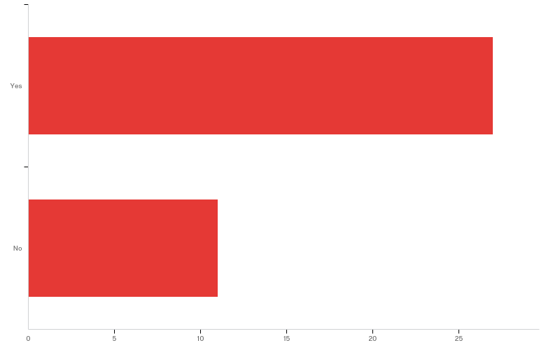
Q13 - Would you drive more frequently if you were guaranteed a good parking spot?

Slide 14
Q13 - Would you drive more frequently if you were guaranteed a good parking spot?
# | Answer | % | Count
1 | Yes | 71.05% | 27
2 | No | 28.95% | 11
 | Total | 100% | 38

Slide 15
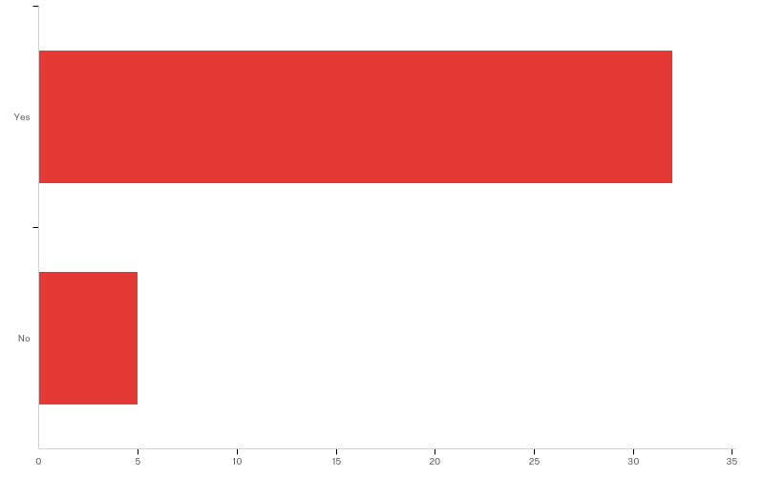
Q14 - Would you drive more frequently if you didn’t have to find a park (i.e. get directed right to a free space)?

Slide 16
Q14 - Would you drive more frequently if you didn’t have to find a park (i.e. get directed right to a free space)?
# | Answer | % | Count
1 | Yes | 86.49% | 32
2 | No | 13.51% | 5
 | Total | 100% | 37

Slide 17
Q15 - Do you have any comments about this section of the survey
Do you have any comments about this section of the survey
Interesti g
I always have to drive to work and to study. I pay sometimes for work parking and always for study parking. I would drive more frequently to other events if I didn't have to find a park, especially in high demand areas like Brisbane City, Burleigh, Southport etc
Thank you for opportunity
Currently my daily parking is paid by another organisation
No
If you could have a secure spot and no one else could take it but you it would relieve the stress out of looking for a park before work or recreational activities esp in the city.
No
I would drive more frequently if I was knew i'd be directed to a park, however if I knew that the free space was very far away from my destination, then I would search for alternatives such as public transport. That is, the reason to drive is inconvenience. However if the degree to which the free space is inconvenient is higher than the inconvenience of public transport, then I will take public transport over it.

Slide 18
Q15 - Do you have any comments about this section of the survey
Do you have any comments about this section of the survey
Would not drive more frequently if it was easier to park, as I don't mind walking to my destination.
It's sounding like an interesting idea

Slide 19
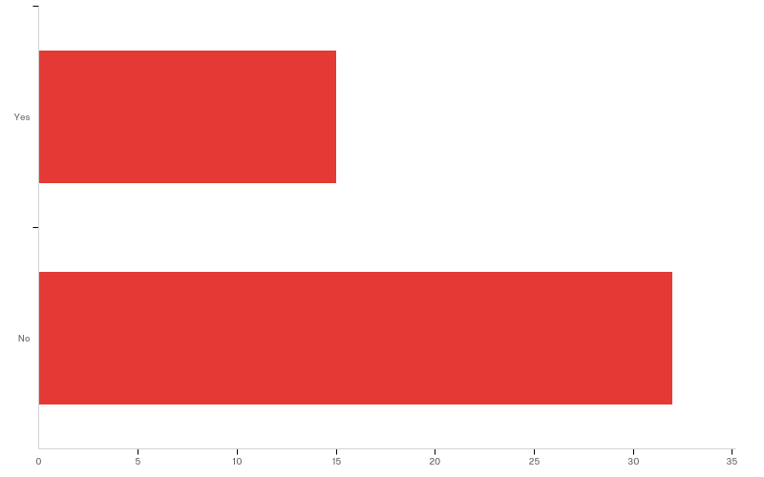
Q16 - Do you own a space which could accommodate a vehicle?

Slide 20
Q16 - Do you own a space which could accommodate a vehicle?
# | Answer | % | Count
1 | Yes | 31.91% | 15
2 | No | 68.09% | 32
 | Total | 100% | 47

Slide 21
Q17 - What would incentivise you to rent that space out to other members of the community?
What would incentivise you to rent that space out to other members of the c...
Money
How much I'd get in rent
I wouldn't
A very good reason of requirement and realistically financial benefit.
Money
Money
Monetray payment or trade of favours.
I'm not allowed to rent that space out
money

Slide 22
Q18 - What concerns would you have in renting that space out to other members of the community?
What concerns would you have in renting that space out to other members of...
I have a company vehicle and this would be against company policy
None
If it would be available when I needed it
My grandchildrens safety playing in yard
its shared space already
Their abuts to the space and perhaps conflict and contention.
Being occupied when you return from work and need it yourself
Is it worth it
No trust or confidence that community client would respect my requests about the space, not having flexibility to say when my space is available, conflict with the client, the effort involve in asking for payment in-person, debt-collection is client did not pay up, client being rude or unpleasant.
The space I have is in a public car park subsidised by a company

Slide 23
Q18 - What concerns would you have in renting that space out to other members of the community?
What concerns would you have in renting that space out to other members of...
security

Slide 24
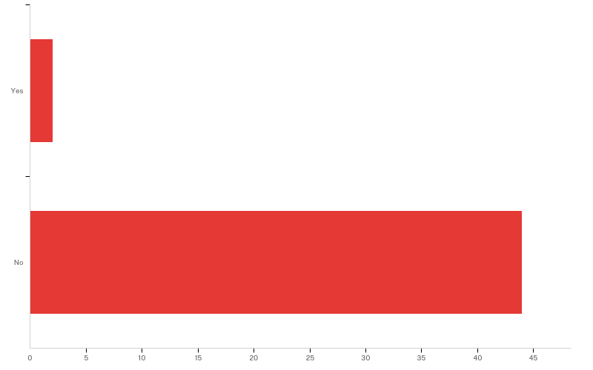
Q19 - Do you own a boat / trailer which requires long term storage?

Slide 25
Q19 - Do you own a boat / trailer which requires long term storage?
# | Answer | % | Count
1 | Yes | 4.35% | 2
2 | No | 95.65% | 44
 | Total | 100% | 46

Slide 26
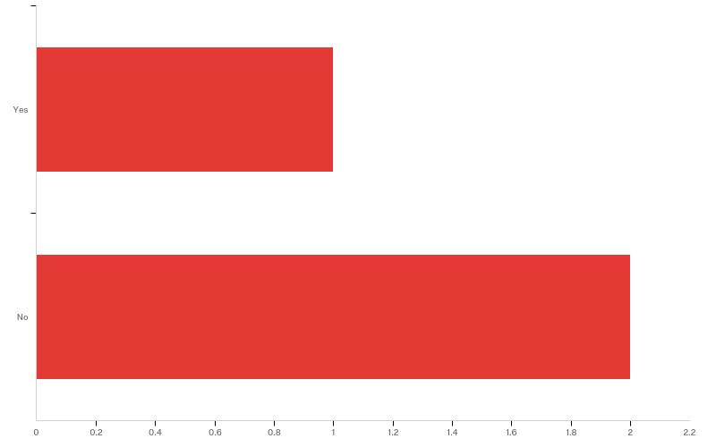
Q20 - Would you be willing to store your boat / trailer at another location for a fee?

Slide 27
Q20 - Would you be willing to store your boat / trailer at another location for a fee?
# | Answer | % | Count
1 | Yes | 33.33% | 1
2 | No | 66.67% | 2
 | Total | 100% | 3

Slide 28
Q21 - If No, what are your concerns?
If No, what are your concerns?
Money
How high the fee would be or increase on special occasions / seasons.

Slide 29
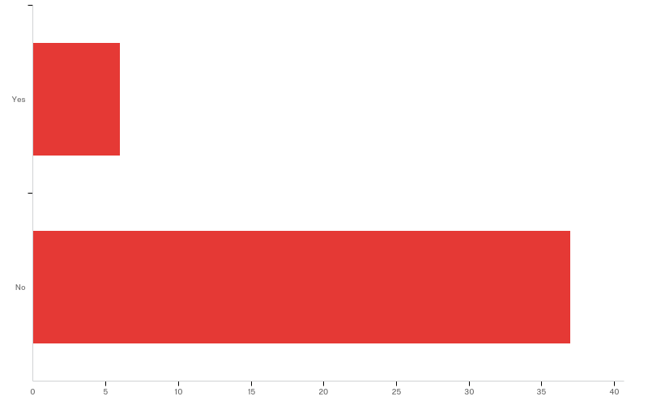
Q22 - Do you have a space which could be used for long term storage for a boat / trailer?

Slide 30
Q22 - Do you have a space which could be used for long term storage for a boat / trailer?
# | Answer | % | Count
1 | Yes | 13.95% | 6
2 | No | 86.05% | 37
 | Total | 100% | 43

Slide 31
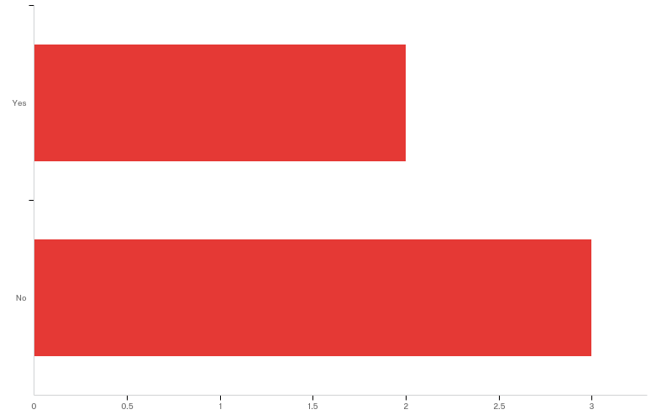
Q24 - If yes, would you be willing to lease out space for some incentive?

Slide 32
Q24 - If yes, would you be willing to lease out space for some incentive?
# | Answer | % | Count
1 | Yes | 40.00% | 2
2 | No | 60.00% | 3
 | Total | 100% | 5

Slide 33
Q25 - If No, what are your concerns?
If No, what are your concerns?

Slide 34
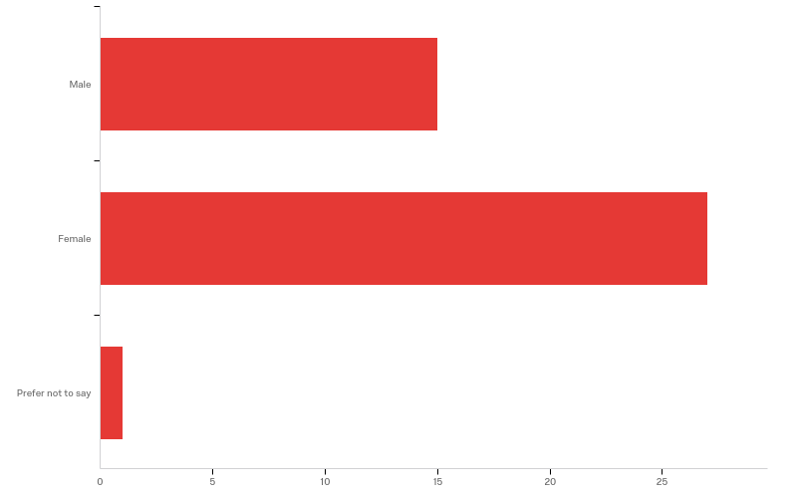
Q26 - What is your gender?

Slide 35
Q26 - What is your gender?
# | Answer | % | Count
1 | Male | 34.88% | 15
2 | Female | 62.79% | 27
3 | Prefer not to say | 2.33% | 1
 | Total | 100% | 43

Slide 36
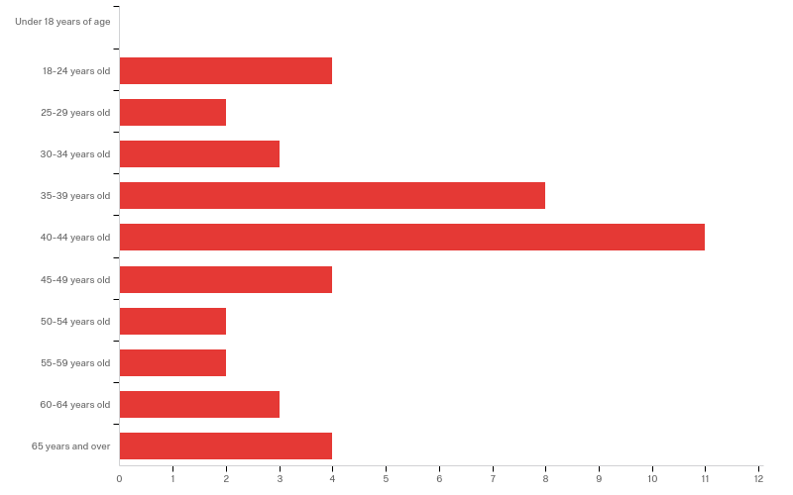
Q28 - Age

Slide 37
Q28 - Age
# | Answer | % | Count
1 | Under 18 years of age | 0.00% | 0
2 | 18-24 years old | 9.30% | 4
3 | 25-29 years old | 4.65% | 2
4 | 30-34 years old | 6.98% | 3
5 | 35-39 years old | 18.60% | 8
6 | 40-44 years old | 25.58% | 11
7 | 45-49 years old | 9.30% | 4
8 | 50-54 years old | 4.65% | 2
9 | 55-59 years old | 4.65% | 2
10 | 60-64 years old | 6.98% | 3
11 | 65 years and over | 9.30% | 4

Slide 38
Q28 - Age
# | Answer | % | Count
 | Total | 100% | 43

Slide 39
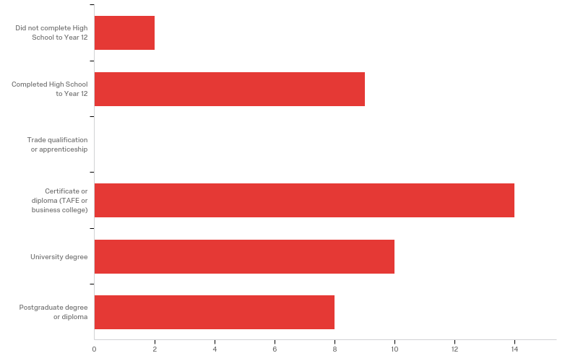
Q30 - Education

Slide 40
Q30 - Education
# | Answer | % | Count
1 | Did not complete High School to Year 12 | 4.65% | 2
2 | Completed High School to Year 12 | 20.93% | 9
3 | Trade qualification or apprenticeship | 0.00% | 0
4 | Certificate or diploma (TAFE or business college) | 32.56% | 14
5 | University degree | 23.26% | 10
6 | Postgraduate degree or diploma | 18.60% | 8
 | Total | 100% | 43

Slide 41
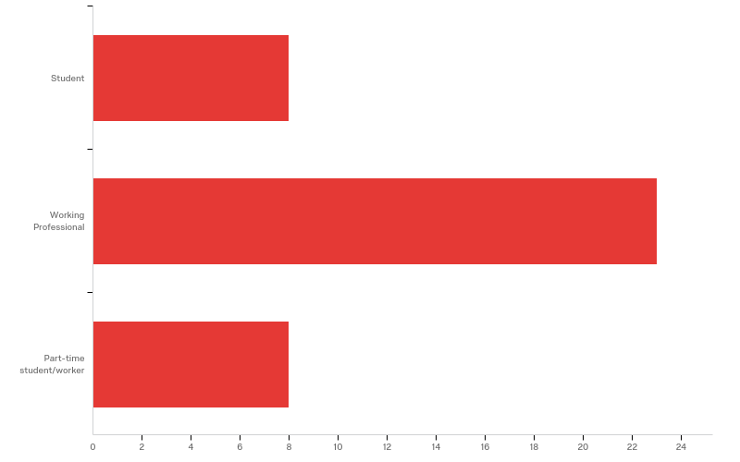
Q31 - Which of the following best describes your current occupation?

Slide 42
Q31 - Which of the following best describes your current occupation?
# | Answer | % | Count
1 | Student | 20.51% | 8
2 | Working Professional | 58.97% | 23
3 | Part-time student/worker | 20.51% | 8
 | Total | 100% | 39

Slide 43
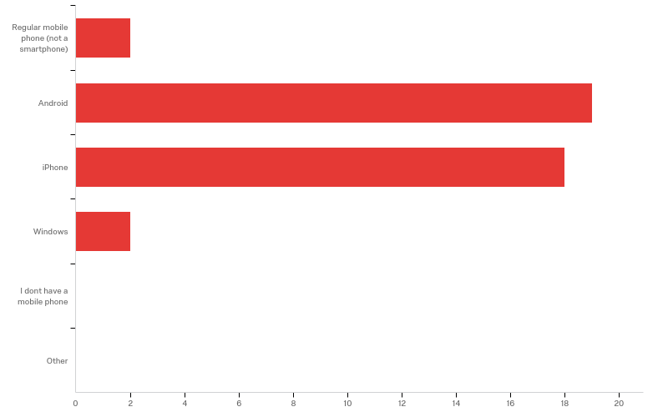
Q33 - What type of mobile telephone do you MAINLY use?

Slide 44
Q33 - What type of mobile telephone do you MAINLY use?
# | Answer | % | Count
1 | Regular mobile phone (not a smartphone) | 4.88% | 2
2 | Android | 46.34% | 19
3 | iPhone | 43.90% | 18
4 | Windows | 4.88% | 2
5 | I dont have a mobile phone | 0.00% | 0
6 | Other | 0.00% | 0
 | Total | 100% | 41

Slide 45
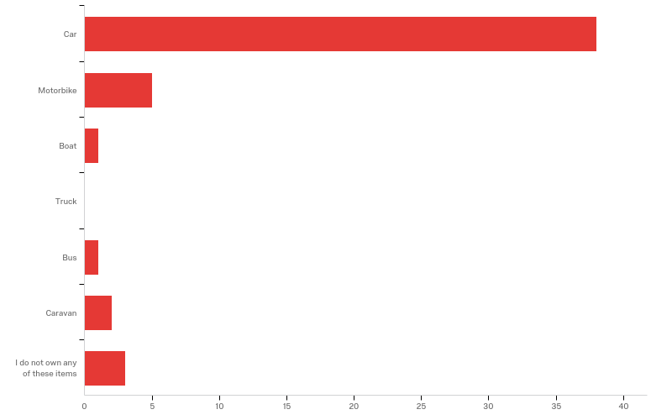
Q34 - Do you own any of the following vehicles (you may tick multiple boxes)?

Slide 46
Q34 - Do you own any of the following vehicles (you may tick multiple boxes)?
# | Answer | % | Count
1 | Car | 76.00% | 38
2 | Motorbike | 10.00% | 5
3 | Boat | 2.00% | 1
4 | Truck | 0.00% | 0
5 | Bus | 2.00% | 1
6 | Caravan | 4.00% | 2
7 | I do not own any of these items | 6.00% | 3
 | Total | 100% | 50

Slide 47
Q37 - Location and postcode
Suburb/Town | Postcode
Ni mRhborough | 4650
Castle Hill | 2154
Kingston | 4114
Annerley | 4103
Penrith | 2750
Forest Lake | 4078
Moorooka | 4105
Leichhardt | 2040
Eagleby | 4207
Queensland Ipswich | 4305
Noble Park | 3174

Slide 48
Q37 - Location and postcode
Suburb/Town | Postcode
Zillmere | 4034
Sunnybank Hills | 4109
 | 4507
Annerley | 4103
Redcliffe | 4020
Boronia Heights QLD | 4124
Boronia | 3155
Kew East | 3102
Brisbane
Pacific pines | 4211
Charters towers | 4820

Slide 49
Q37 - Location and postcode
Suburb/Town | Postcode
Collingwood Park | 4301
Mapleton | 4560
Kelmscott | 6111
Rochedale south | 4123
Liverpool | 2170
Ropes Crossing | 2760
Thirroul NSW | 2515
Kew East | 3102
Horningsea park | 2171
Eastlakes | 2018
Croydon park | 2133

Slide 50
Q37 - Location and postcode
Suburb/Town | Postcode
Coorparoo | 4151
Goodna | 4300
Annerley | 4103
Coorparoo | 4151
Coorparoo | 4151

